Slide 1
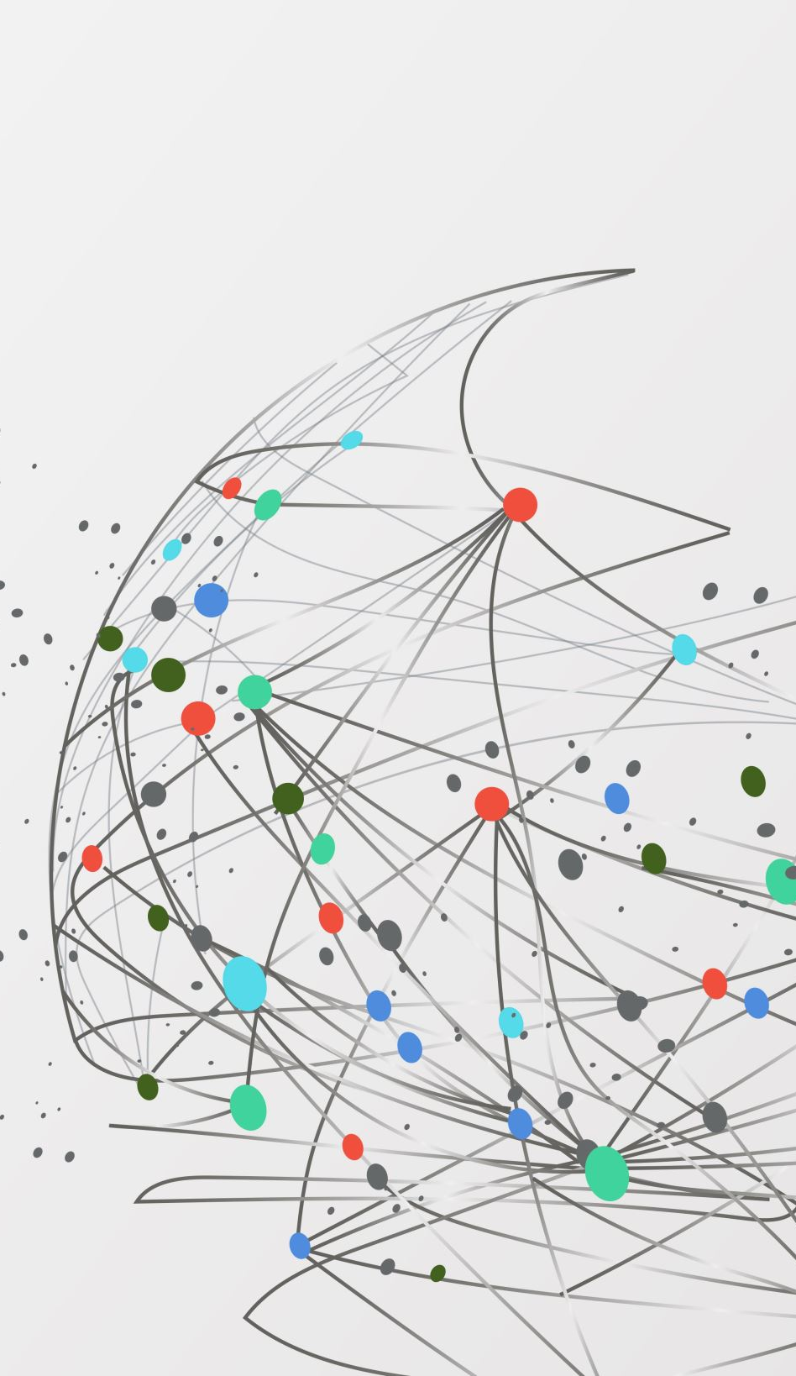
Paper Review
By Daniel Eneh
PhD Applicant

Slide 2
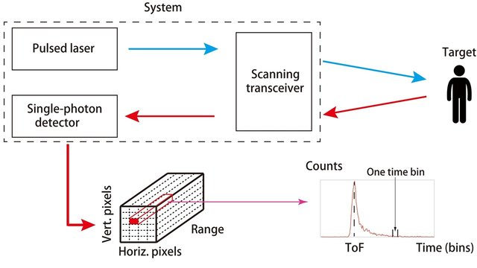
RESTORATION OF INTENSITY AND DEPTH IMAGES RECONSTRUCTION USING SPARSE SINGLE PHOTON DATA
doi: 10.1109/EUSIPCO.2016.7760215.
The algorithm only processes corrupted depth and images from the Time Correlated Single-Photon Counting. This technique can result to a problem where some pixels might be empty known as Inpainting. This can be resolved by adopting a cost function that contains a non-zero value to model lost image pixels.
The paper proposes a technique to recover depth and image intensity from time correlated single-photon counting measurement with limited photon counts.
Image Restoration Technique
Inpainting
The total variation assumes spatially correlated pixels to improve the image estimates
An ADDM algorithm which combines restoration using :
Total Variation Regularization
The Discrete Cosine Transform assumes the sparseness of the vectors to improve the image estimate.
Discrete Cosine Transform Regularization

Slide 3
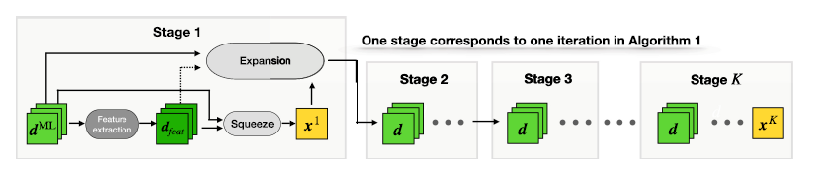
A BAYESIAN BASED DEEP UNROLLING ALGORITHM FOR SINGLE-PHOTON LIDAR SYSTEM
doi: 10.1109/JSTSP.2022.3170228.
Each STAGE of the Neural Network has 2 main blocks
SQUEEZE BLOCK
This paper proposes a deep learning / neural network for the reconstruction of images from a single photon lidar system that mimics an iterative Bayesian Algorithm.
The SQUEEZE block : It selects the scale with highest attention weight for each pixel and takes the single depth value on that scale.
EXPANSION BLOCK
The EXPANSION Block : It updates the multiscale depths based on the obtained squeezed depth.

Slide 4
References
A. Halimi et al., "Restoration of intensity and depth images constructed using sparse single-photon data," 2016 24th European Signal Processing Conference (EUSIPCO), Budapest, Hungary, 2016, pp. 86-90, doi: 10.1109/EUSIPCO.2016.7760215.
J. Koo, A. Halimi and S. McLaughlin, "A Bayesian Based Deep Unrolling Algorithm for Single-Photon Lidar Systems," in IEEE Journal of Selected Topics in Signal Processing, vol. 16, no. 4, pp. 762-774, June 2022, doi: 10.1109/JSTSP.2022.3170228.

